Slide 1


Tata Elxsi

Slide 2

Business Description
Tata elxsi is the branch of famous Tata group of companies which handles the technological division of the Tata group. The company operates in multiple industries like Automobile, broadcast and media, consumer appliances, healthcare, rail, semiconductors and telecommunications.
The stock trades on NSE and BSE as their primary exchanges .
The stock operates at 6666.00INR

Slide 3
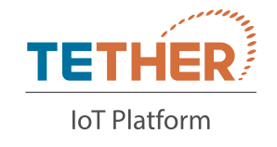




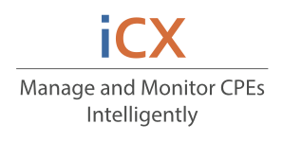
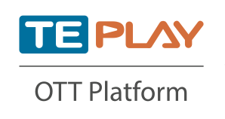


Brand Portfolio
01
05
02
06
03
07
04
08

Slide 4

Industrial Outlook
Digital Tech Hotbed
Growing up Creation Focus
30-32% revenues from digital;66% of deals largely digital.
290+ cross border digital focused M&A
1430+ GCCs of which 43% are portfolio/transformation hubs
138k tech patents filed by firms in India during 2015-2021
India ranked 46th in Global Innovation Index
1.5X increase in R&D investments.
3rd Largest Startup Hub In The World
Leading in Hybrid Work Models
25,000+ tech start-ups 2250+ founded in 2021
290+ cross border digital focused M&A
$24 Bn funding raised in 2021 highest ever
42 new unicorns, 11 IPOs in 2021
70% of tech organization are looking at adopting hybrid work models
Virtual screening, recruitment , onboarding and training becoming the norm

Slide 5
Industrial Outlook
With a 10-15% market
share, he country is
Gradually establishing itself
as an engineering and
design centre for
Automobiles , aerospace,
consumer electronics,
machinery, and
semiconductors
IT software industry has
massively contributed a 7.2%
rise in India’s GDP in the year
2022
According to NASSCOM,
India’s contribution to the
global ER&D market is
predicted to increase from
US$ 31 Billion in CY 2019 to
US$ 63 Billion by CY 2025 at
a CAGR of 12-13%. Of this, it
is expected that Indian ER&D
service provider’s market
would be witnessing at an
Impressive CAGR of around
17%.
IT Industry’s contribution to India’s GDP

Slide 6

Industrial Outlook
According to Zinnov and JP Morgan estimates, The Indian ER&D market is expected to grow at a rate of 13% CAGR till the year 2030-2031
According to Grand View
Research, in CY 2021, the global
telecom services market was
roughly worth US$ 1,708 Billion. It
is estimated to record a CAGR of
5.4% from CY 2021 to CY 2028.
Drivers for the market expansion
include increasing demand for
high-speed connectivity, explosive
growth in consumer generated
multimedia content for OTT
applications, and growing number
of mobile users
2021 saw the global Healthcare
Industry rapidly move towards
digitalisation .Digital technologies and
the data they generate are being
increasingly used by
health professionals, policymakers and
individuals worldwide to improve
health and well-being

Slide 7
Shortlisting Analysis
The growth of the company is strongly projected in its statistics . The company has shown a 37.5% YoY growth on its revenue
The Indian Software Industry has
Shown immense growth in the past
decade and has a lot more growth
opportunities in the upcoming future
for the development of India , and
this opportunities have provided and
will continue to provide increased
revenue to growing companies
like Tata Elxsi.
This company is the key R&D division
providing inputs to various subsidiaries
Of the Tata group of Companies , like
Tata Motors etc.
The COVID-19 might have proved a boon for The IT industry , it has accelerated the growth of the industry by 5-10% and the company has shown in considerable amounts in the time of the pandemic
The schemes allotted by the GOI in the
BUDGET 2023 shows huge growth
opportunities for the company.
The LIC group also has increased its
stake in the TATA Group by 1.6%, Such
stakeholders which have large market
capitalizations show a sentiment of
trust in the Tata Group in the market .
This usually increases the price of the
stocks of the companies related to the
TATA Group of companies.
The stock P/E is 58.1 while the Industry
P/E being 32.7
This company has proved its identity in
The Indian R&D sector by its diversified
Brand Portfolio providing solutions to
complex problems in each of the
sectors like Healthcare,
Telecommunications etc.
This company has been outperforming
the market which becomes the primary
reason to invest in this company

Slide 8
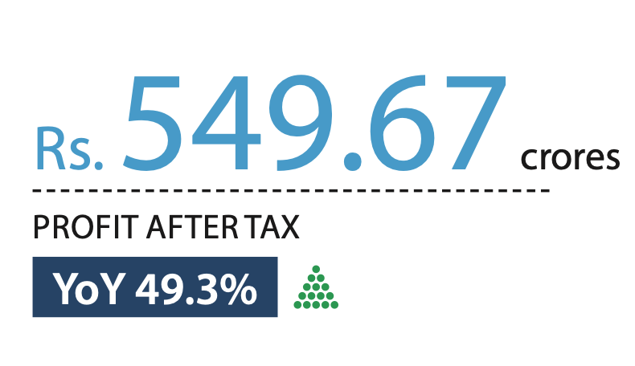
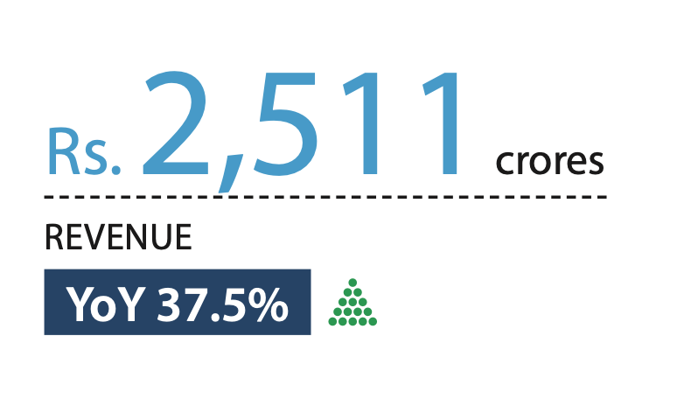
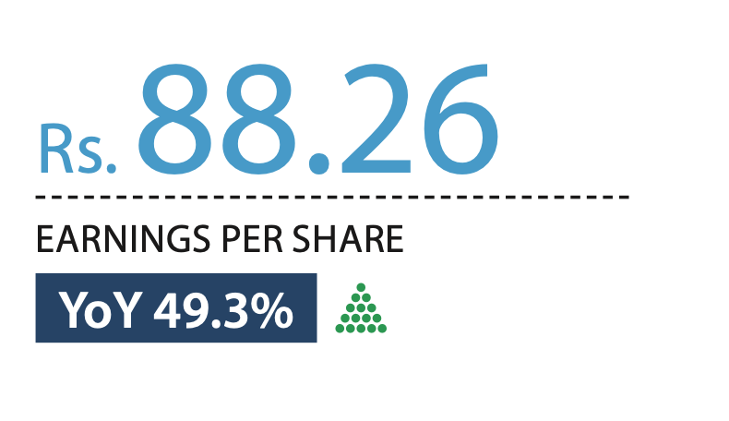
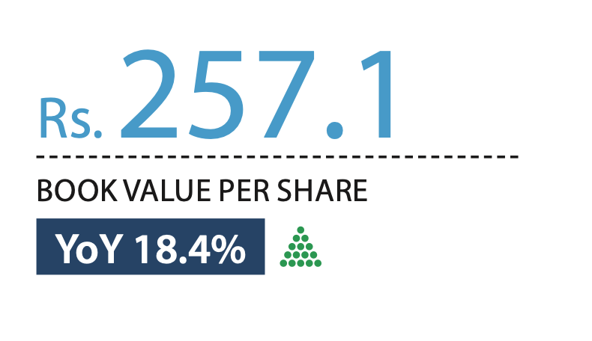
Company At a Glance

Slide 9
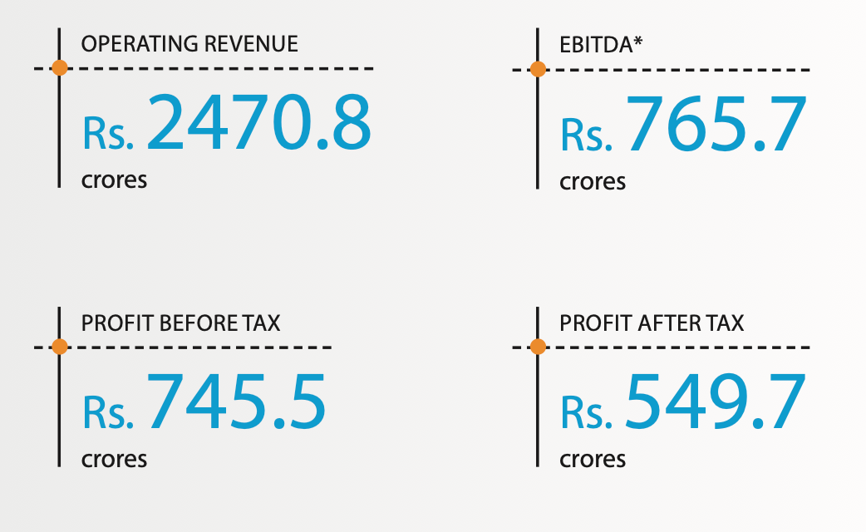
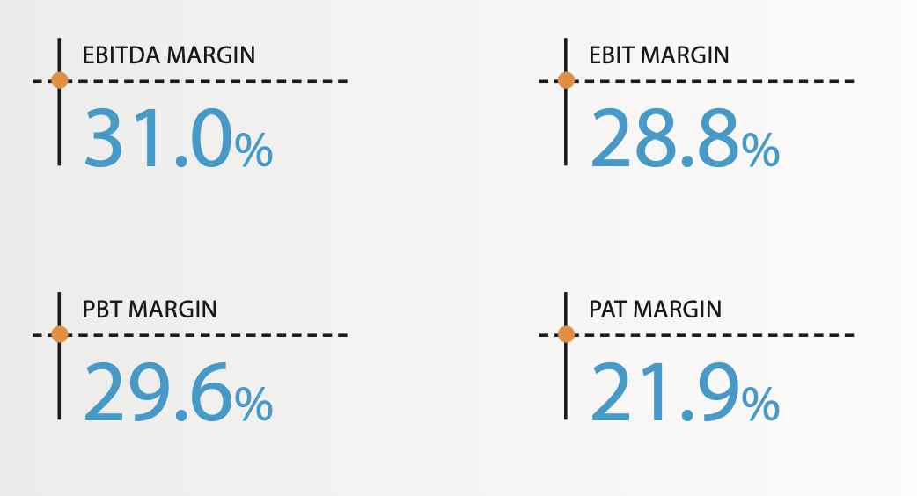
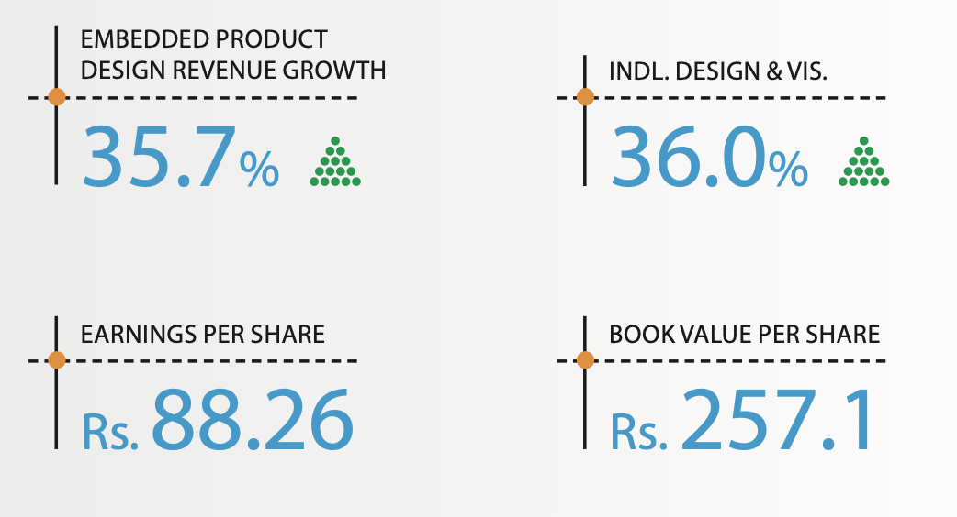
Company At a Glance

Slide 10
Company At a Glance

Slide 11
Key Ratios
Market Cap. | P/E | ROCE | ROE | OPM | Debt to Equity | Debt to Profit
Rs. 41,494 Cr. | 58.1 | 47.7% | 37.2% | 31.2% | 0.11% | 0.34
OPM Last Year | Profit Growth in 5Yrs | Sales Growth in 5Yrs | PEG | Industry P/E | Dividend Yield | Price to Book Value
31 | 25.9% | 14.8% | 2.25 | 32.7 | 0.64% | 24.5

Slide 12
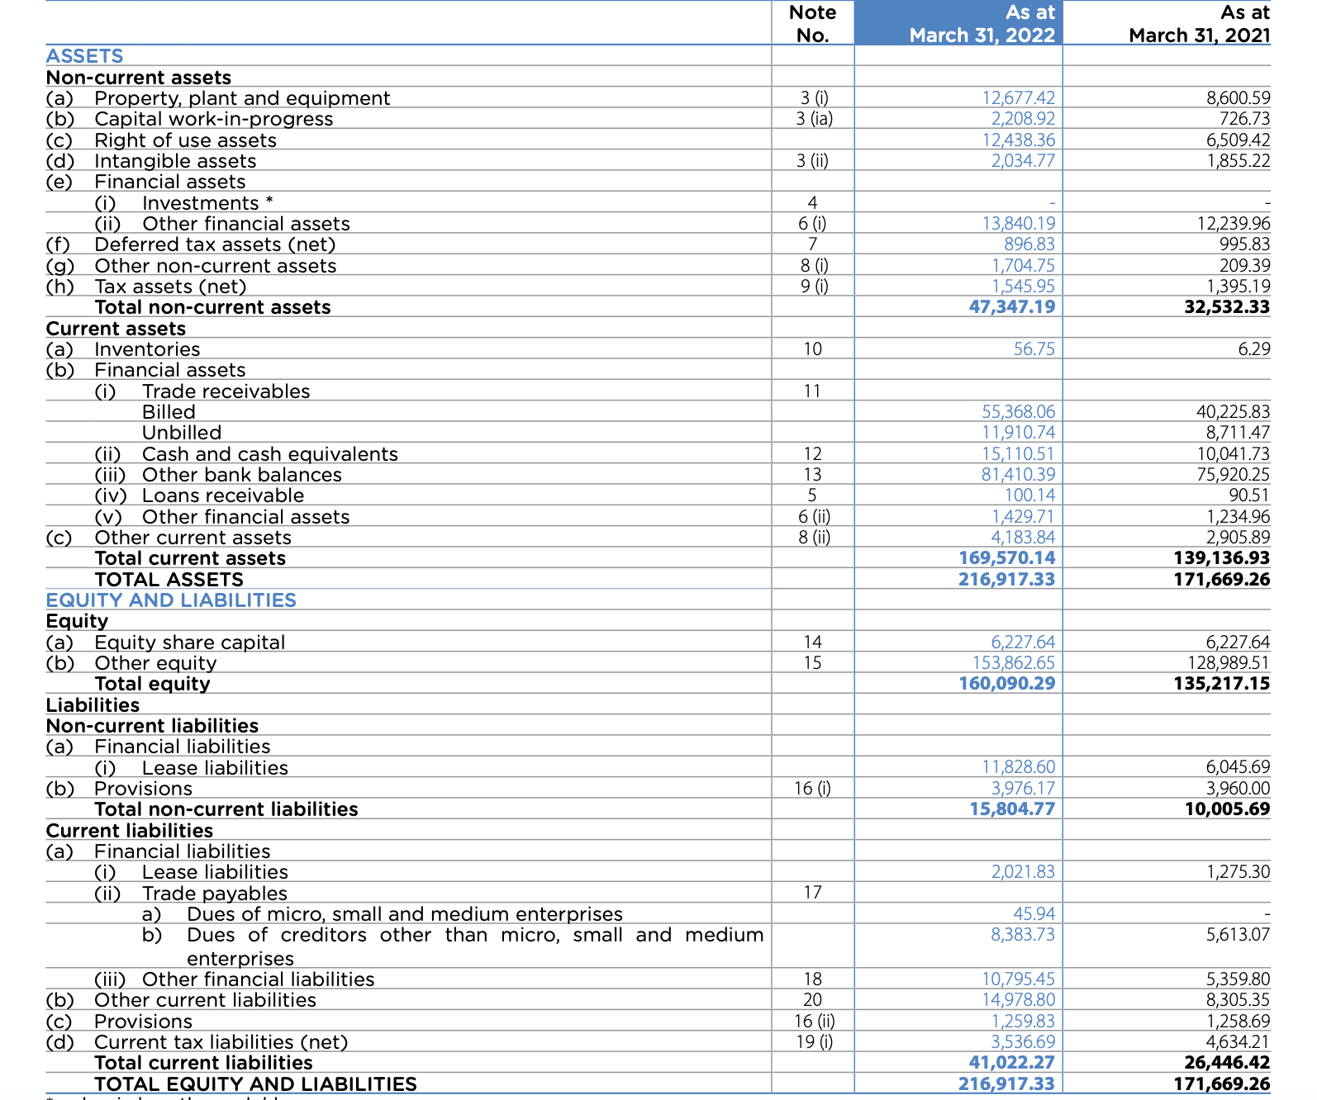
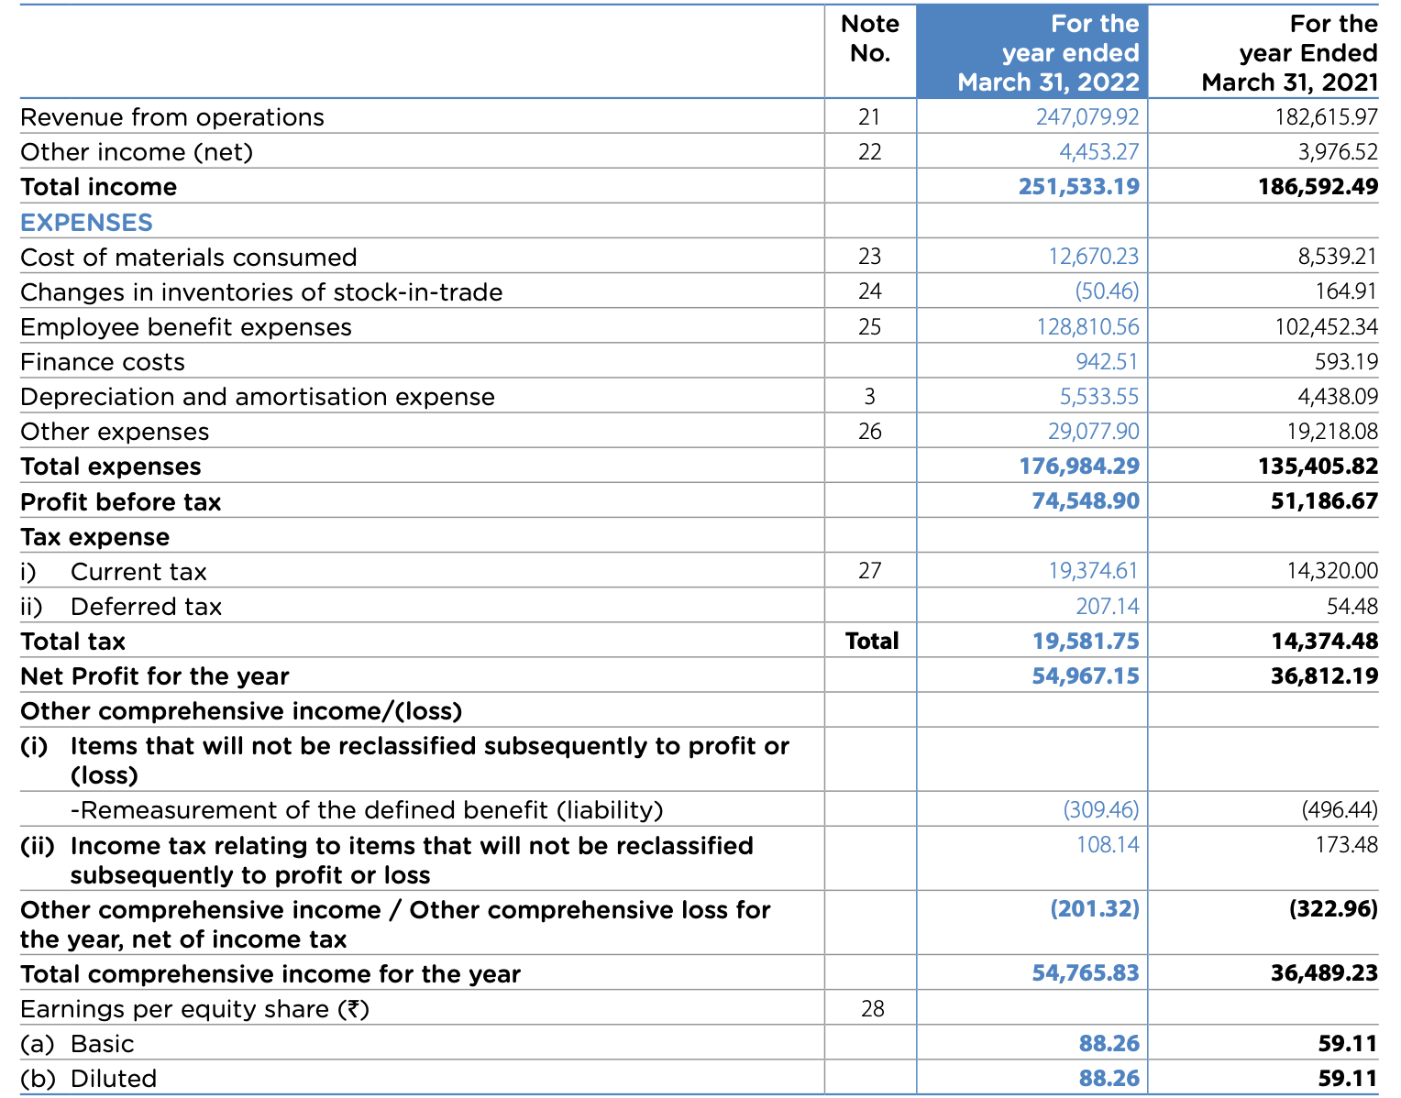
Company Financials

Slide 13
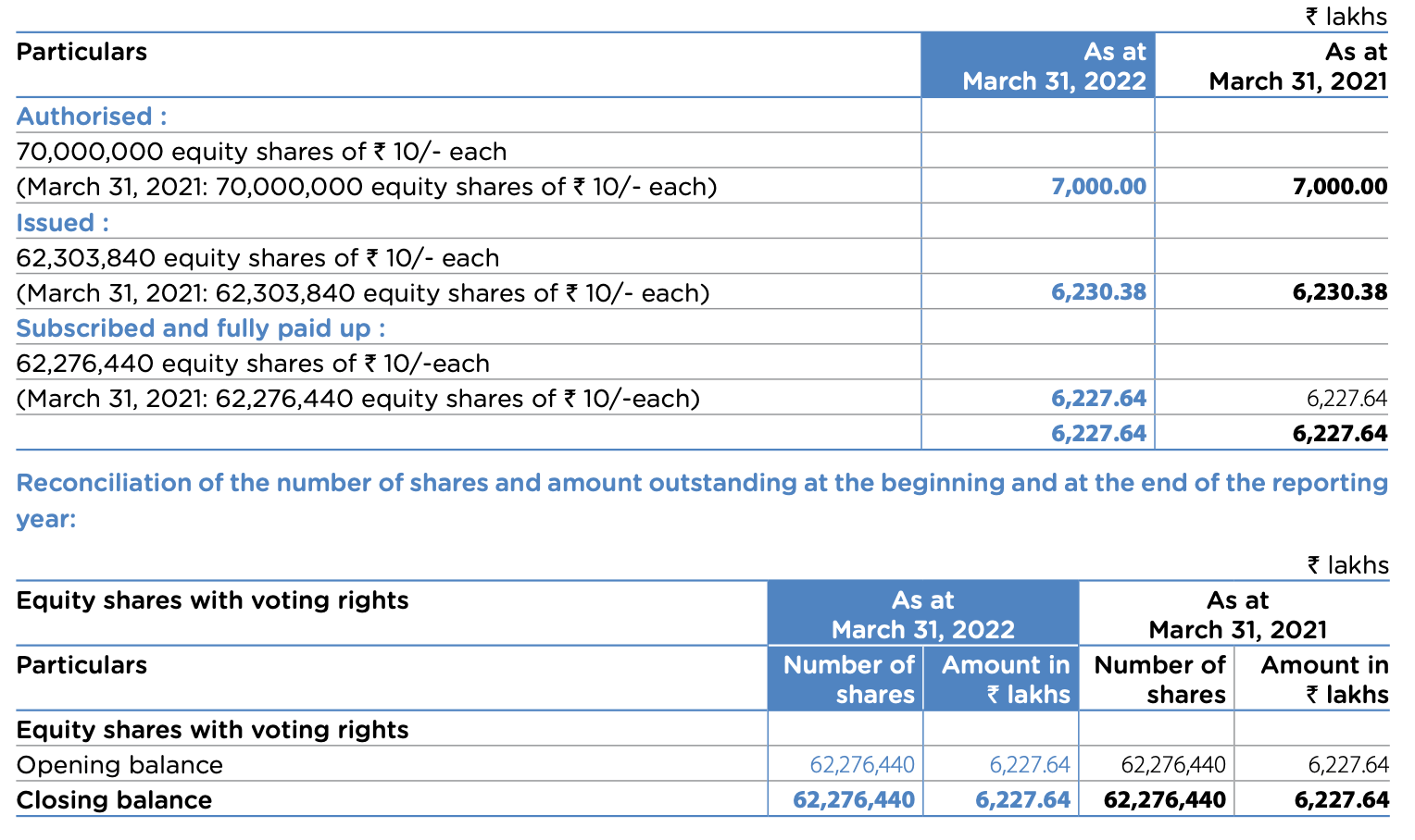
Shareholding Pattern

Slide 14
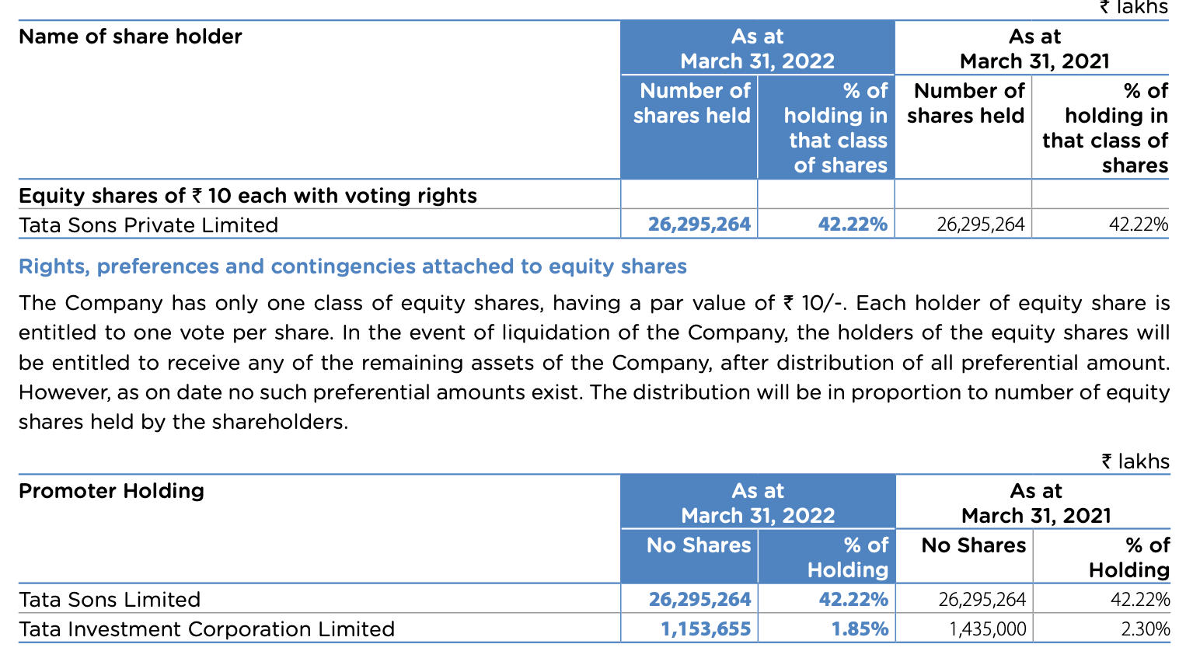
Shareholding Pattern

Slide 15
Investment Hypothesis
The “Ayushman Bharat Digital Mission” , An open platform, for the National Digital Health Ecosystem will be rolled out. It will consist of digital registries of health providers and health facilities, unique health identity, consent framework, and universal access to health facilities. A revolutionary mission being carried out by the Government of India , provides huge impetus to the growth of the Healthcare industry in India .
“The contracts for laying optical fibre in all villages, including remote areas, will be awarded under the Bharatnet project through PPP in 2022- 23. Completion is expected in 2025. Measures will be taken to enable better and more efficient use of the optical fibre.”, As quoted in the Budget allocated by the GOI in 2023 , shows the further growth plans for the existing telecommunications industry in India
The automotive industry worldwide as well
as in India, The crowd is massively shifting
Towards EV’s as well as automated driving
systems which favor the IT industry
developing hi-tech VR solutions and ML/AI
driven solutions applicable to the Electric
Vehicles being manufactured in the market.
A scheme for design-led manufacturing
Will be launched to build a strong
ecosystem for 5G as part of the
Production Linked Incentive
Scheme, which will further grow the
Telecommunications sector in India
Huge tech giants like tesla envision India
to be the next upcoming manufacturing
hub in the semiconductor Industry after
places like Taiwan etc. The could be a
great opportunity for companies like Tata
Elxsi which are a part of the
Semiconductor Industry in India.
Software giants like Google are planning
on to invest upto $5 Billion which can
prove to be a great opportunity for the
company. They can get into collaboration
with companies like google to help them
with their ventures in India.

Slide 16
Risks and Concerns
The company operates at a PEG ratio
of 2.25 .Generally a PEG ratio>1means
that the stock is overvalued
The company also risks from Inflation
which can increase its expenses and
operating revenues etc.
.
Tata Elxsi is one of its kind company
which has a profitable semiconductor
division operating in the Indian
Semiconductor Market. The ongoing
Geo-Political tensions have affected
the semiconductor industries all over
the world with India being no
exception. This has significantly
affected the revenue of the
semiconductor division of the
company.
“The company’s 42.2% of revenue comes from The United States of America. The company is always at currency risk’s about rupee devaluating and its adverse consequences.
Being in the domain of technology, the
Company faces cyber security risks
from any possible source in the world.

Slide 17
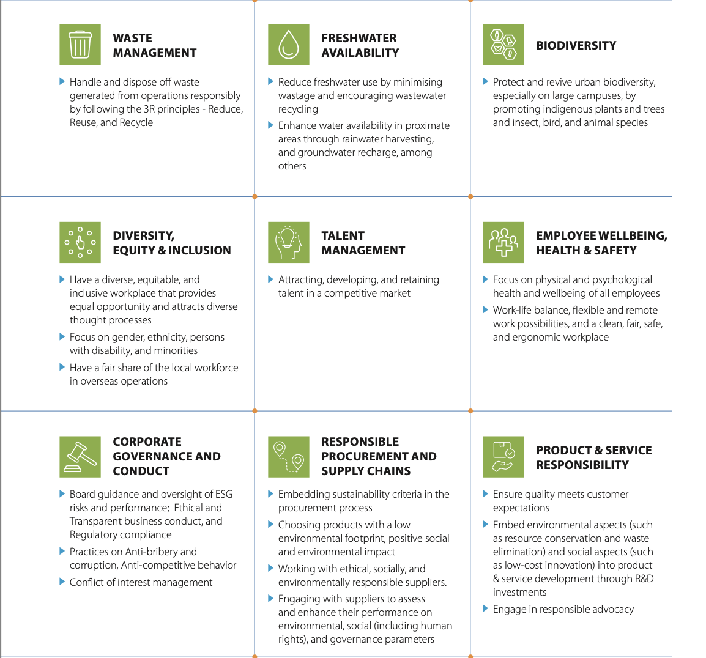
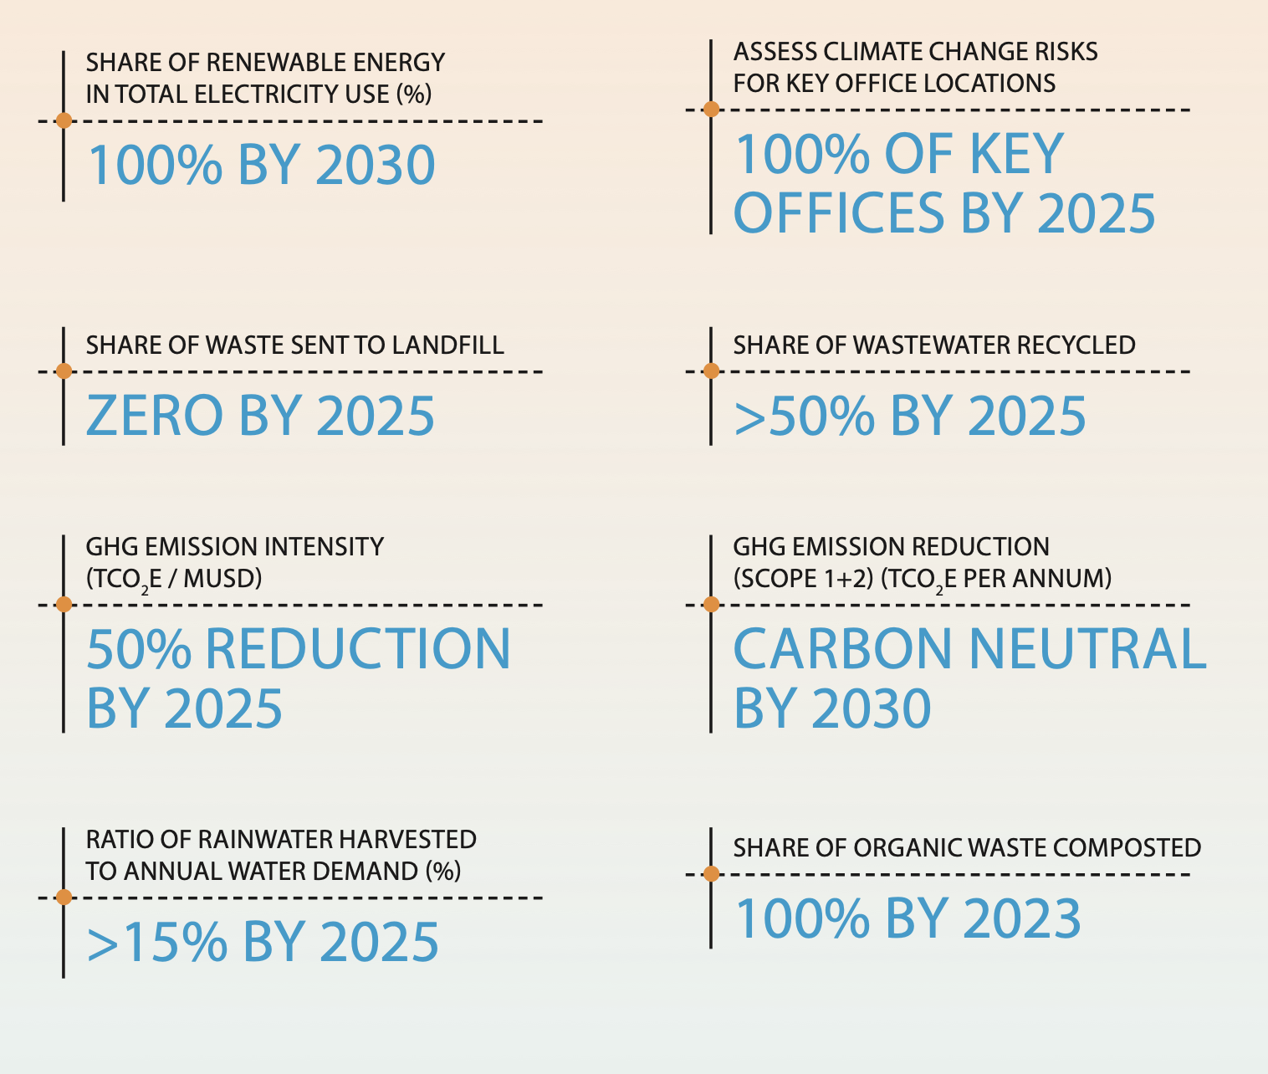

ESG Analysis
Environmental
Governance
Social
The company has set a target to go carbon
neutral by 2030.The company has developed
plans to reduce their energy consumption,
Increase the share of renewable energy and
accelerate awareness of climate change and
energy conservation. In addition, all of the
company’s offices and establishments are aligned
with energy efficiency targets and have replaced
conventional lighting with LED and energy-
efficient equipment.
Regular review of ESG risks by the board committee atleast 2 times by the year 2023.
The company have designed
many programs to contribute to
the society and also help its
employees in various stuff.
Shiksha
Niramay
Sanjeevani
Employee Health Platform
1to1 Help.

Slide 18

MD & CEO
Mr. Manoj Raghavan
Mr. Manoj Raghavan was appointed as the CEO
& MD of Tata Elxsi in October 2019; he has over
25 years of industry experience.
Prior to this he served as the Executive Vice
President and Head of the Embedded Product
Design (EPD) division, spearheading the sales,
overall delivery, and P&L for this division.
He joined Tata Elxsi in 1997 as Regional
Manager to set up and grow Japan operations,
subsequently, he was also responsible for
developing the business in South Korea, Taiwan,
Singapore, and China; more recently, he was
responsible for the North American business and
helped grow the region to become a top revenue
earner for the Company
He holds a B.Tech in Metallurgical Engineering
from IIT Madras, an MBA from The Indian
Institute of Foreign Trade, New Delhi, and has
completed the Advanced Management
Program from Harvard Business School

Slide 19



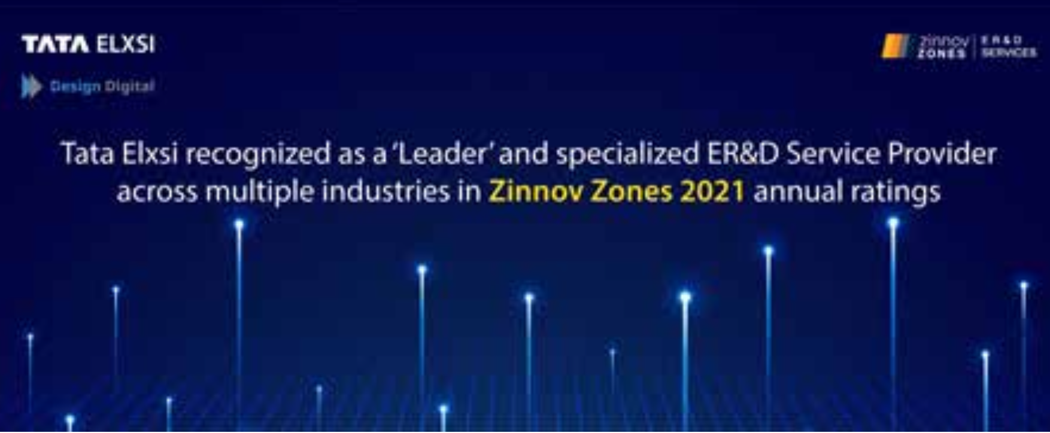
Summing Up
We recommend you to buy the stock at
current levels and exit at convenient
profits in a time of 2 years or more. The
financial ratios , expected future ratios
and current scenario goes in a positive
with the stock. It has a diversified
customer base and a strong distribution
network which can be beneficial for the
long term growth. Additionally the
Parent company is the promoter
shareholder in the organization which is
a positive sentiment in the market. The
Tata sons and Limited is one of the
oldest corporations in India and one the
most trusted ones. The company has
also won many awards in 2021 as
shown alongside which is a remarkable
achievement .

Slide 20

Thanks!

